Slide 1
LEADS Boot Camp
Information Visualization
Erjia Yan

Slide 2
Good resources
https://medium.economist.com/mistakes-weve-drawn-a-few-8cdd8a42d368
https://venngage.com/blog/how-to-choose-the-best-charts-for-your-infographic/
https://www.data-to-viz.com/caveats.html

Slide 3
Introduction
Section I

Slide 4
Information visualization is concerned with the design, development, and application of computer generated interactive graphical representations of information.
Information visualization primarily deals with abstract, nonspatial data.
Transforming such nonspatial data to intuitive and meaningful graphical representations is of fundamental importance to the field.
The transformation is a creative process in which designers assign new meanings into graphical patterns.

Slide 5
The holy grail of information visualization is for users to gain insights.
In general, the notion of insight is broadly defined, including
unexpected discoveries
a deepened understanding
a new way of thinking
eureka-like experiences, and
other intellectual breakthroughs.

Slide 6
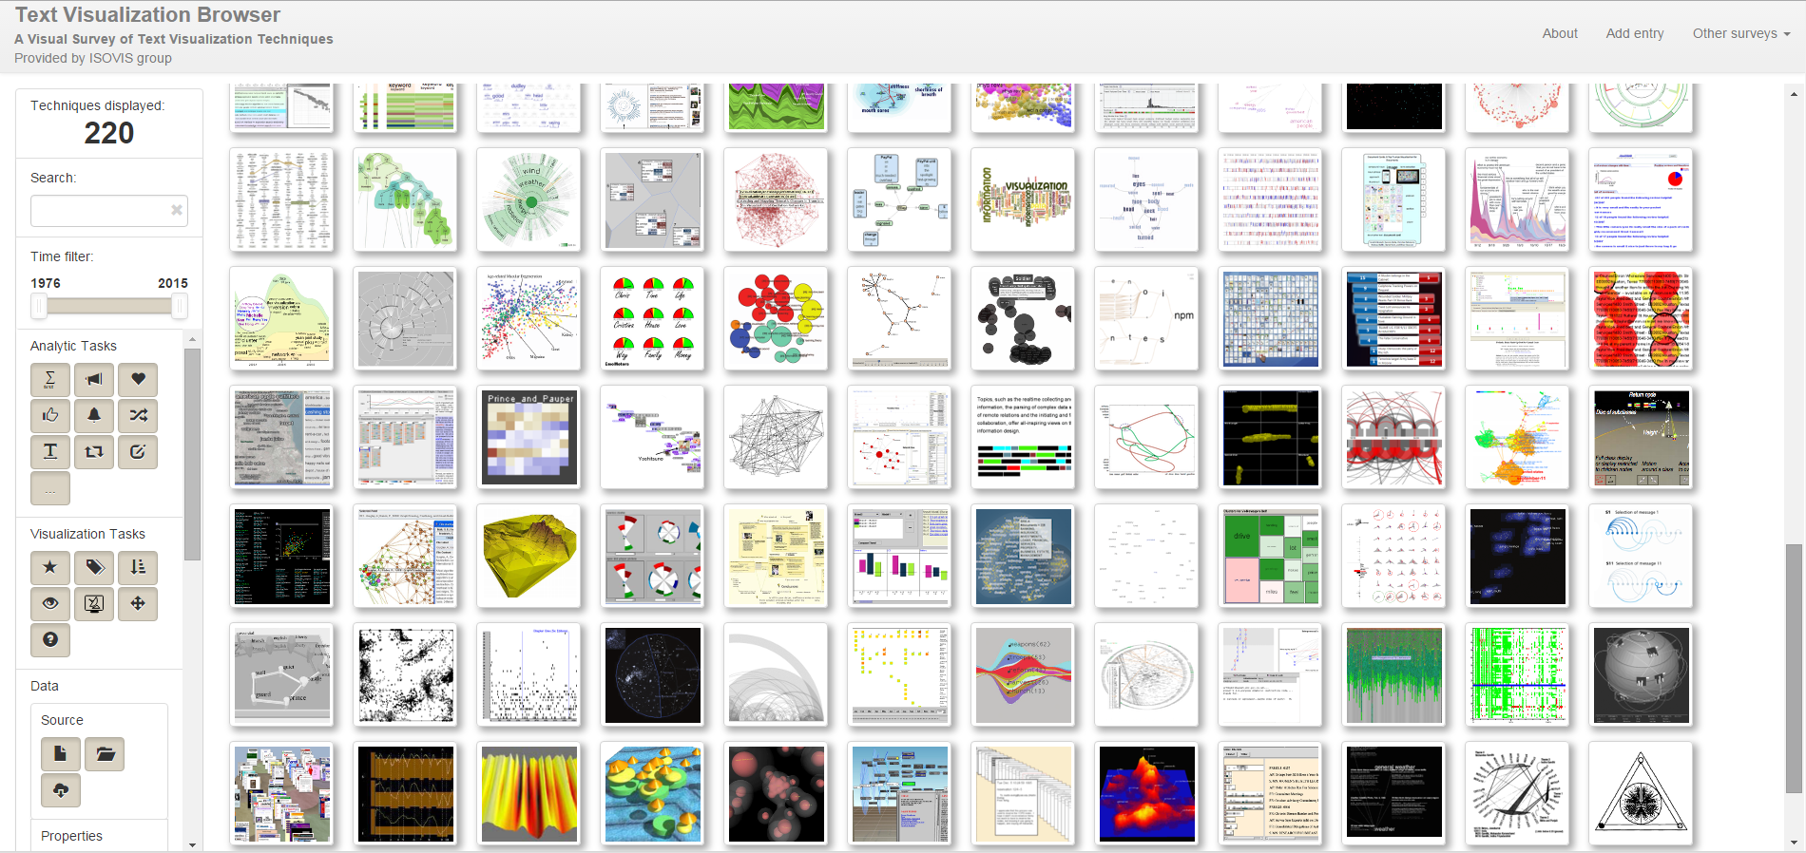
Text Visualization Browser A Visual Survey of Text Visualization Techniques http://textvis.lnu.se/

Slide 7
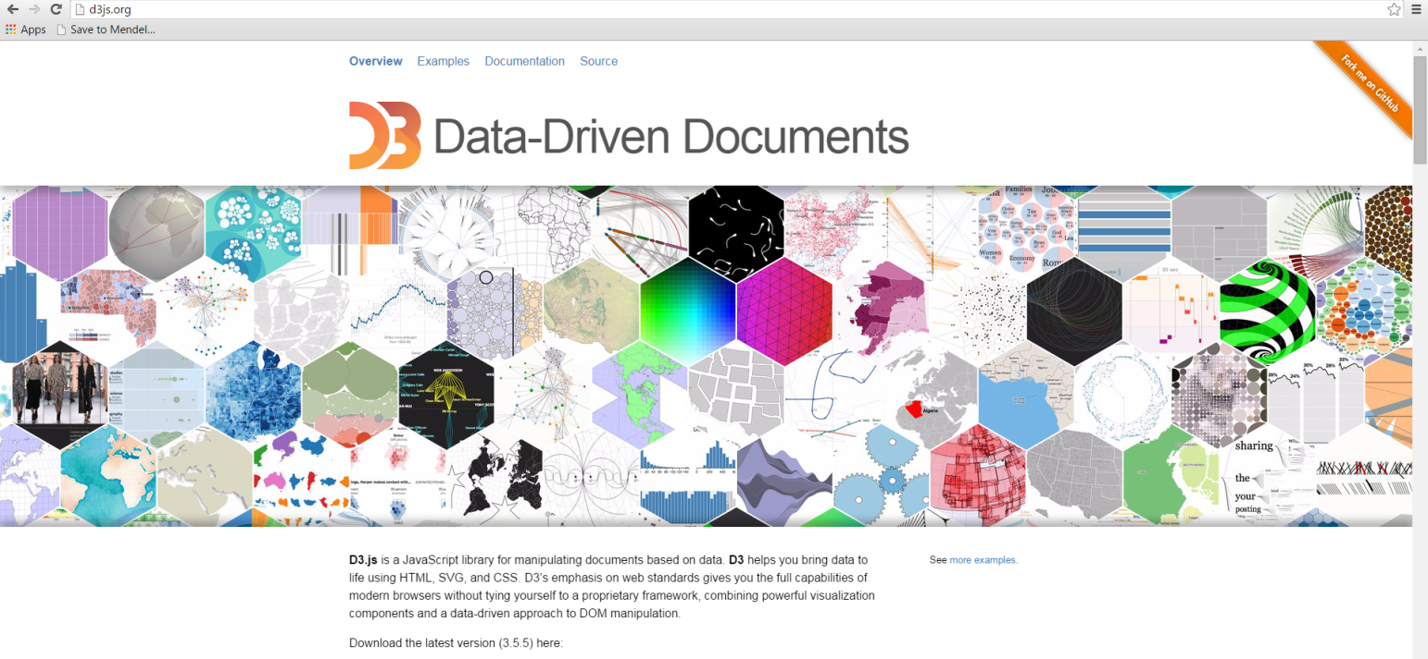
D3 – Data Driven Documents
http://d3js.org/
https://github.com/mbostock/d3/wiki

Slide 8
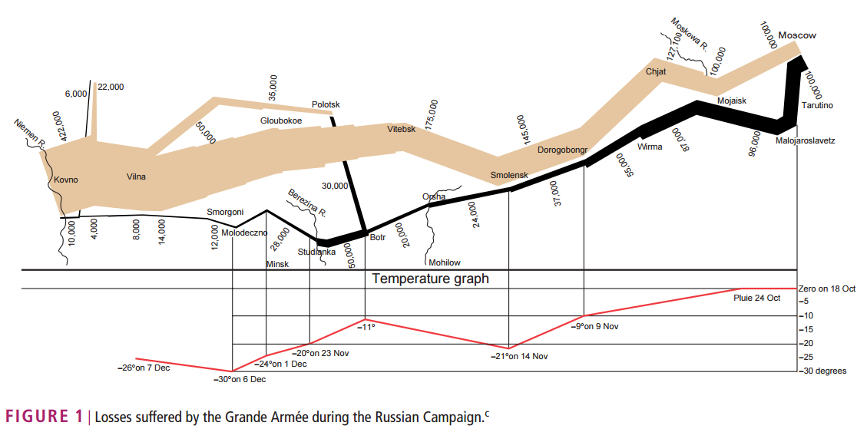

Slide 9
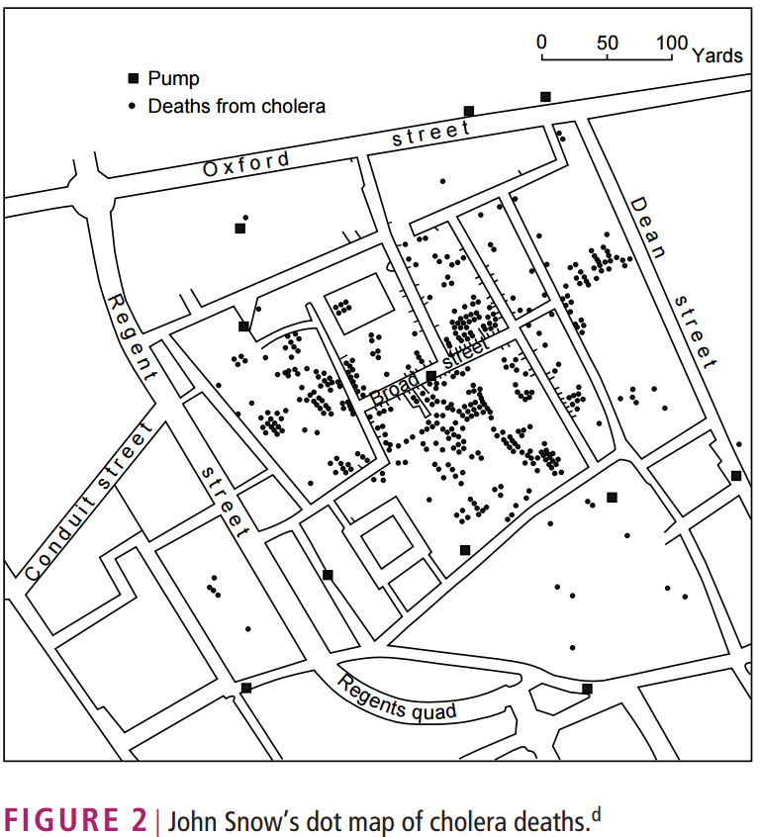

Slide 10
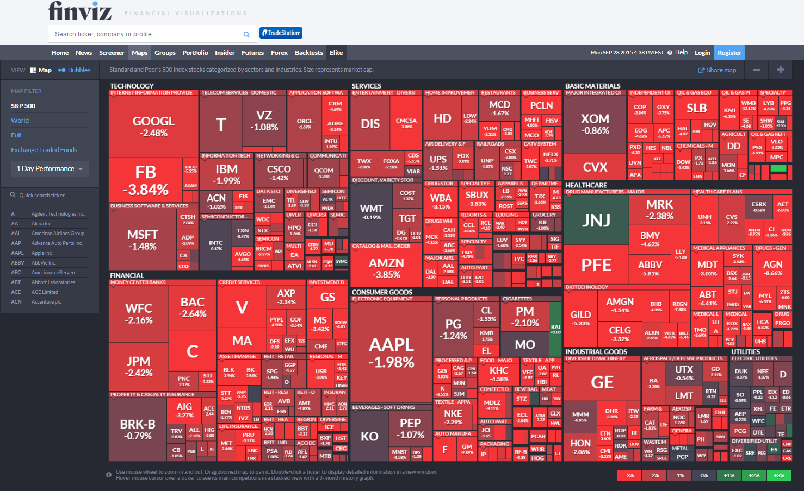
https://finviz.com/map.ashx

Slide 11
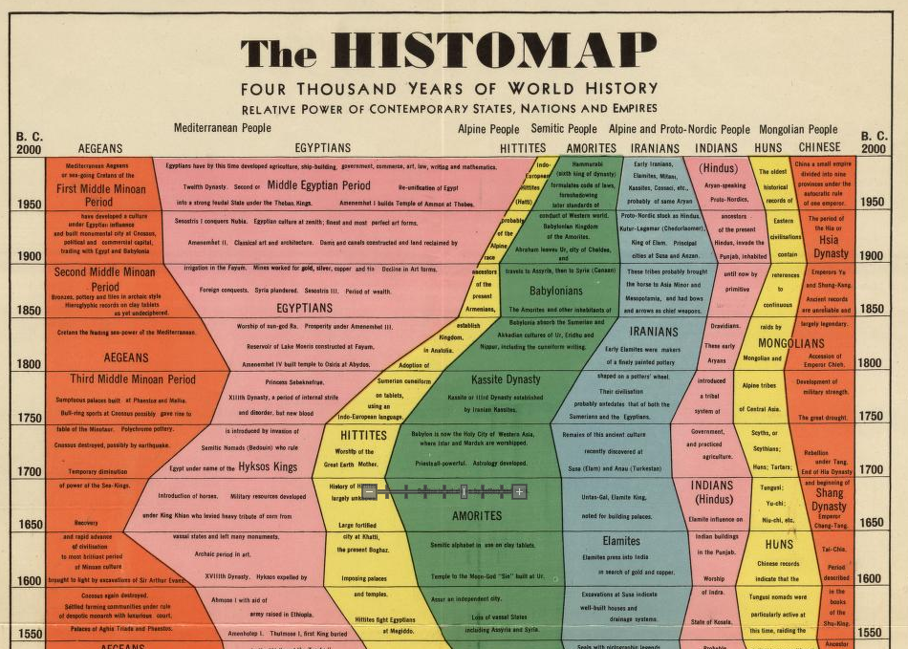

Slide 12
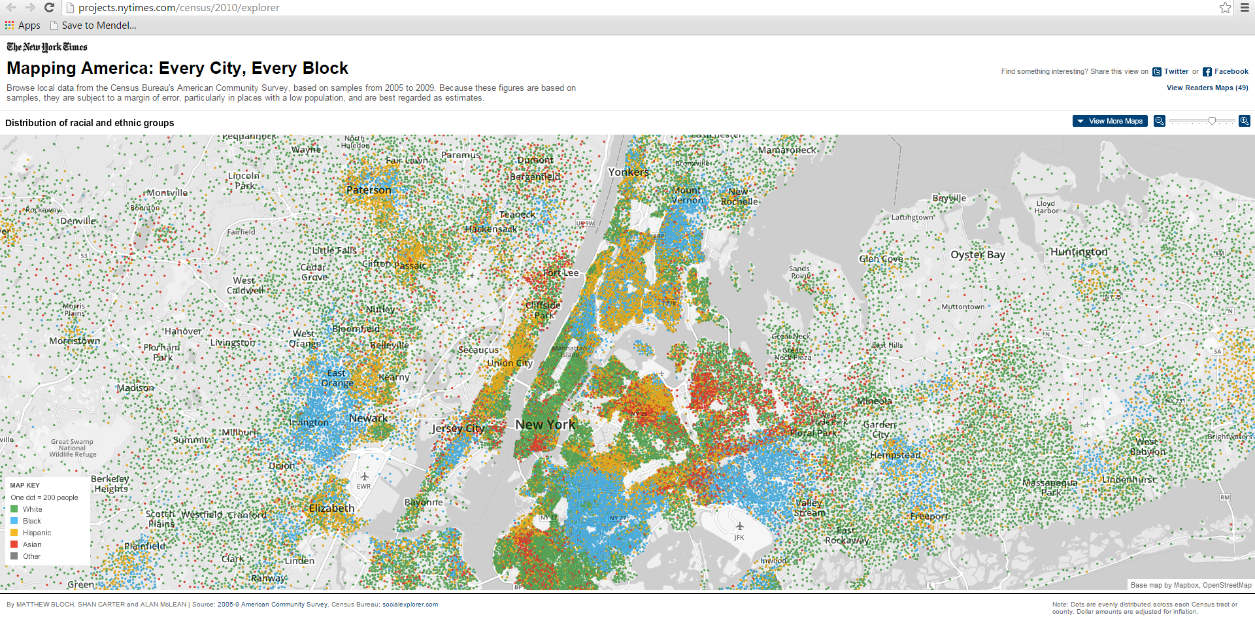

Slide 13
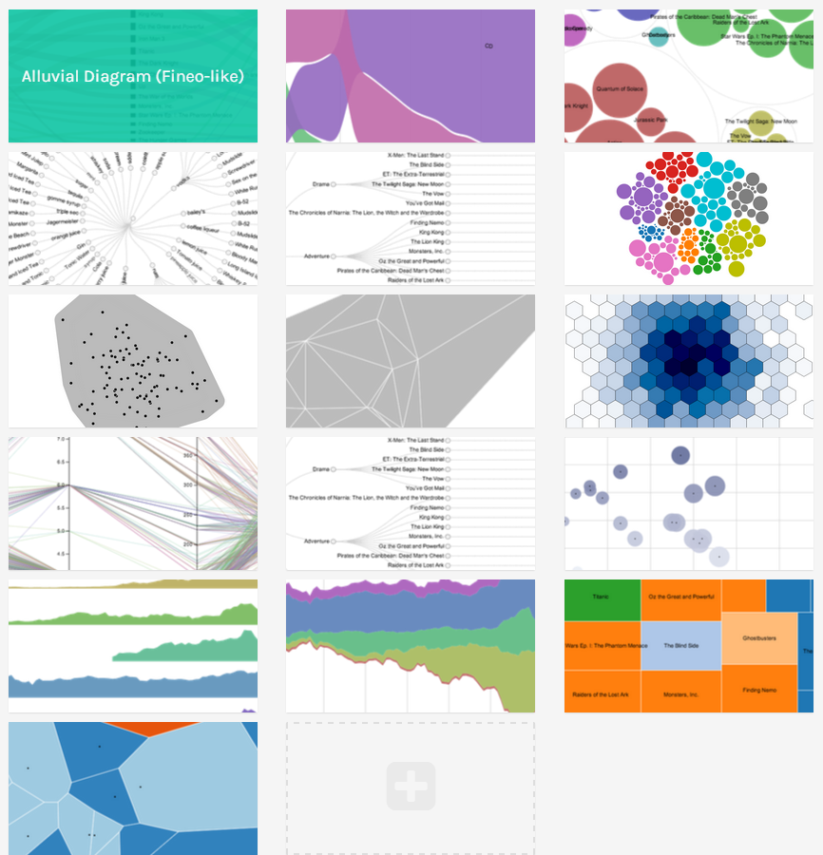
Software: RAW
http://raw.densitydesign.org/

Slide 14
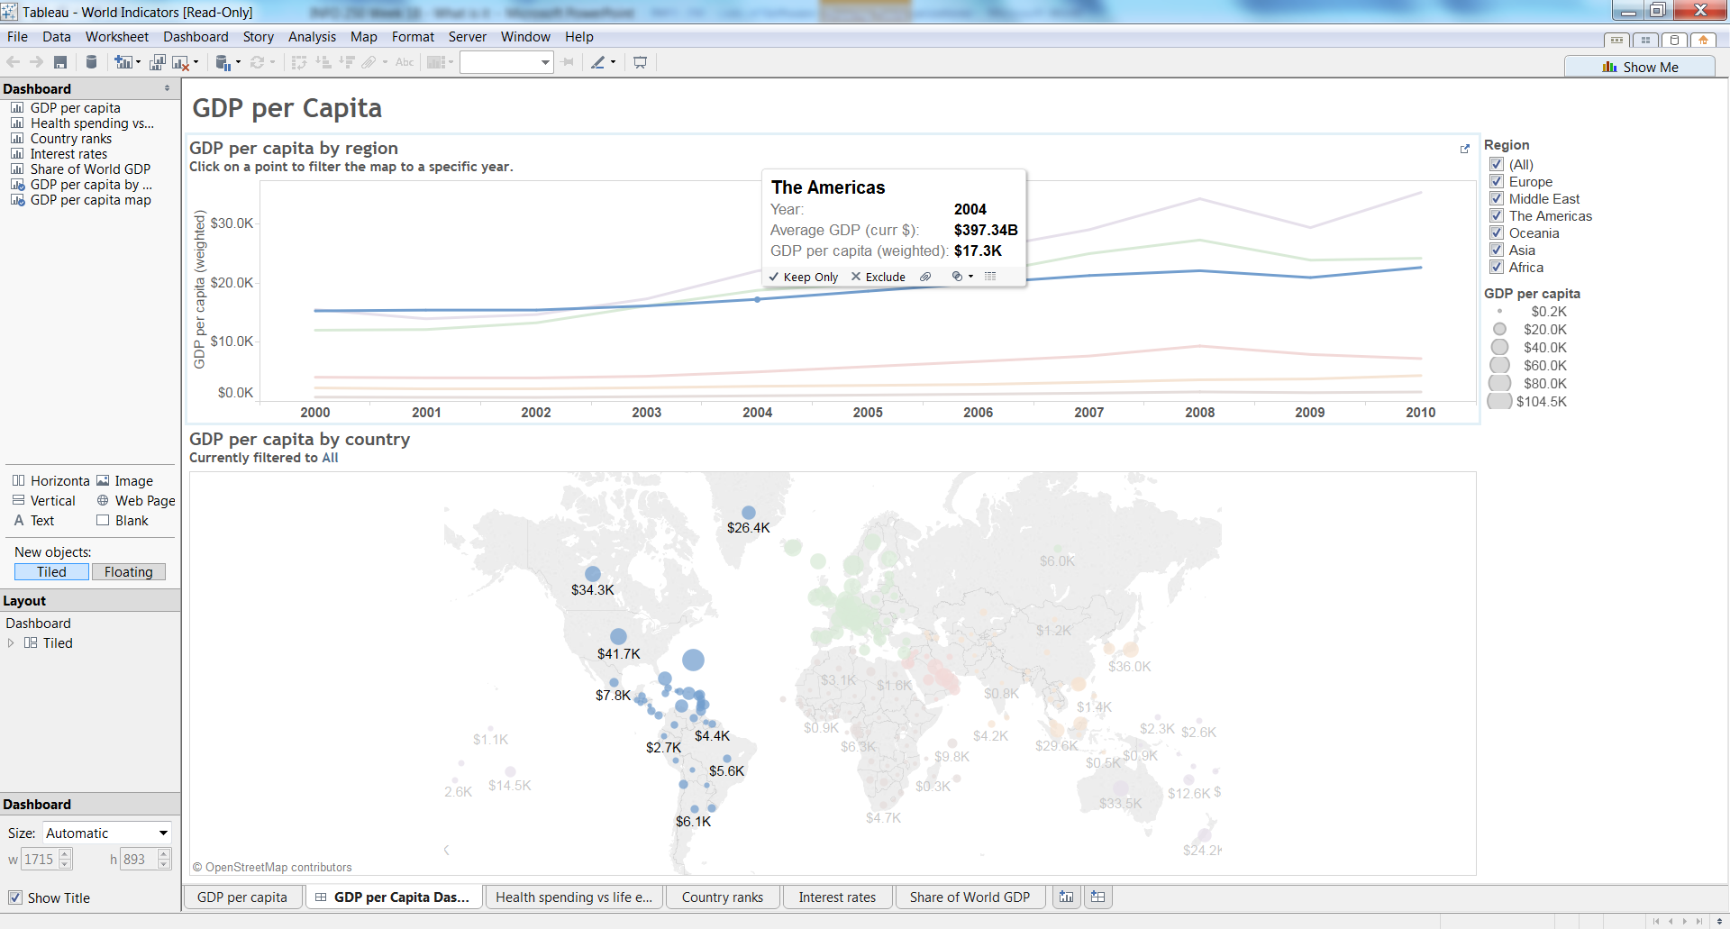
Software: Tableau https://public.tableau.com/s/ Training videos: https://public.tableau.com/en-us/s/resources

Slide 15
Taxonomy
Section II

Slide 16
A Task by Data Type Taxonomy
Shneiderman, B. (1996) The Eyes Have It: A Task by Data Type Taxonomy for Information Visualizations. Proc. of IEEE Symposium on Visual Languages, Los Alamos, pp. 336-343.
This is a classic paper in the field of information visualization.
It proposed a taxonomy in terms of what types of actions would be appropriate for a few common types of data structures.

Slide 17
7 Data Types
1-dimensional
Textual documents, program source code, lists
2-dimensional
Geographic maps, floorplans, newspaper layouts
3-dimensional
Molecules, the human body, buildings
Temporal
Medical records, project management, timeline
Multidimensional
Relational and statistical multivariate data sources
Tree
Parent-children structures, family trees
Network
Node-link structures

Slide 18
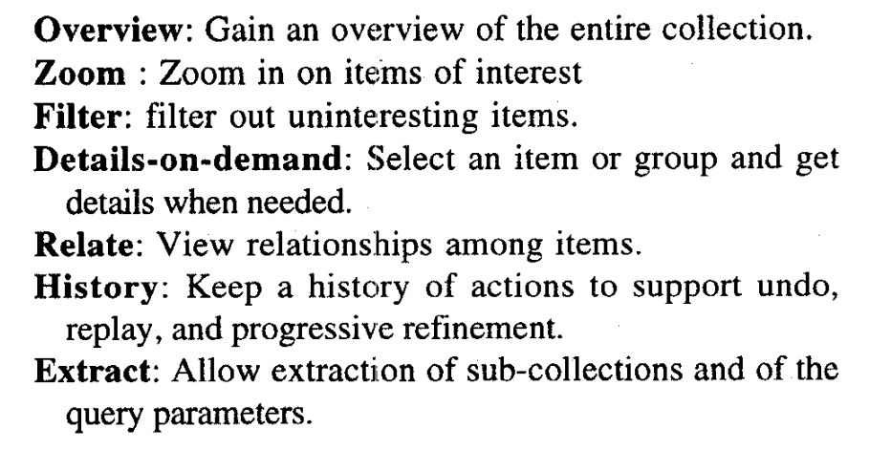
7 Tasks

Slide 19
Mental models
Section III

Slide 20


Slide 21


Slide 22
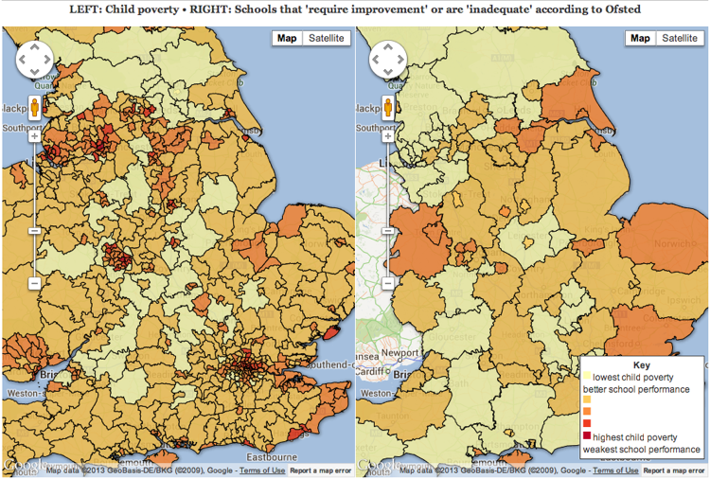

Slide 23
Perception: Why Can't We See What Is There To Be Seen?
Perception is an active rather than a passive process.
It is not as objective as it seems.
It is a process of inference in which people construct their own version of reality on the basis of information provided through the five senses.

Slide 24
Perception is strongly influenced by multiple factors
our past experience,
education,
cultural values, and
role requirements, as well as
the stimuli recorded by their receptor organs

Slide 25
Some Important Properties
Mind-sets tend to be quick to form but resistant to change.
Once events have been perceived one way, there is a natural resistance to other perspectives.
New information is assimilated to existing images.
So, don’t rush it.
Gradual, evolutionary change often goes unnoticed.
It takes more information, and more unambiguous information, to recognize an unexpected phenomenon than an expected one.
Be aware what you are expecting

Slide 26
Initial exposure to blurred or ambiguous stimuli interferes with accurate perception even after more and better information becomes available
This effect has been demonstrated experimentally by projecting onto a screen pictures of common, everyday subjects such as a dog standing on grass, a fire hydrant, and an aerial view of a highway cloverleaf intersection.
The initial projection was blurred in varying degrees, and the pictures were then brought into focus slowly to determine at what point test subjects could identify them correctly.
First, those who started viewing the pictures when they were most out of focus had more difficulty identifying them when they became clearer than those who started viewing at a less blurred stage. The greater the initial blur, the clearer the picture had to be before people could recognize it.
Second, the longer people were exposed to a blurred picture, the clearer the picture had to be before they could recognize it.

Slide 27
Despite ambiguous stimuli, people form some sort of tentative hypothesis about what they see.
The longer they are exposed to this blurred image, the greater confidence they develop in this initial and perhaps erroneous impression, so the greater the impact this initial impression has on subsequent perceptions.
For a time, as the picture becomes clearer, there is no obvious contradiction; the new data are assimilated into the previous image, and the initial interpretation is maintained until the contradiction becomes so obvious that it forces itself upon our consciousness.

Slide 28
Mental models are easy to form, but hard to change
The early but incorrect impression tends to persist because the amount of information necessary to invalidate a hypothesis is considerably greater than the amount of information required to make an initial interpretation.
People form impressions on the basis of very little information, but once formed, they do not reject or change them unless they obtain rather solid evidence.
Analysts might seek to limit the adverse impact of this tendency by suspending judgment for as long as possible as new information is being received.

Slide 29
highly ambiguous situations
incrementally processed information
pressure for early judgment
premature closure
➔
inaccurate perception
Once an observer thinks he or she knows what is happening, this perception tends to resist change.

Slide 30
Keeping an Open Mind
Major intelligence failures are usually caused by failures of analysis, not failures of collection.
Relevant information is discounted, misinterpreted, ignored, rejected, or overlooked because it fails to fit a prevailing mental model or mind-set.

Slide 31
Strategies for Creative Thinking
Deferred Judgment. The principle of deferred judgment is undoubtedly the most important. The idea generation phase of analysis should be separated from the idea-evaluation phase, with evaluation deferred until all possible ideas have been brought out.
This approach runs contrary to the normal procedure of thinking of ideas and evaluating them concurrently. Stimulating the imagination and critical thinking are both important, but they do not mix well.
A judgmental attitude dampens the imagination, whether it manifests itself as self-censorship of one's own ideas or fear of critical evaluation by colleagues or supervisors. Idea generation should be a freewheeling, unconstrained, uncritical process.

Slide 32
Network visualizations
Section IV

Slide 33
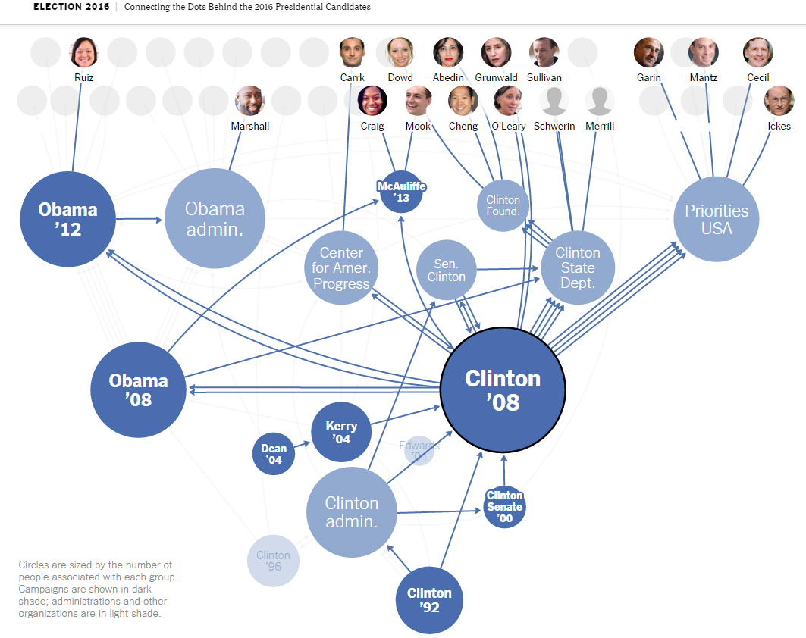
Connecting the Dots Behind the 2016 Presidential Candidates http://www.nytimes.com/interactive/2015/05/17/us/elections/2016-presidential-campaigns-staff-connections-clinton-bush-cruz-paul-rubio-walker.html

Slide 34
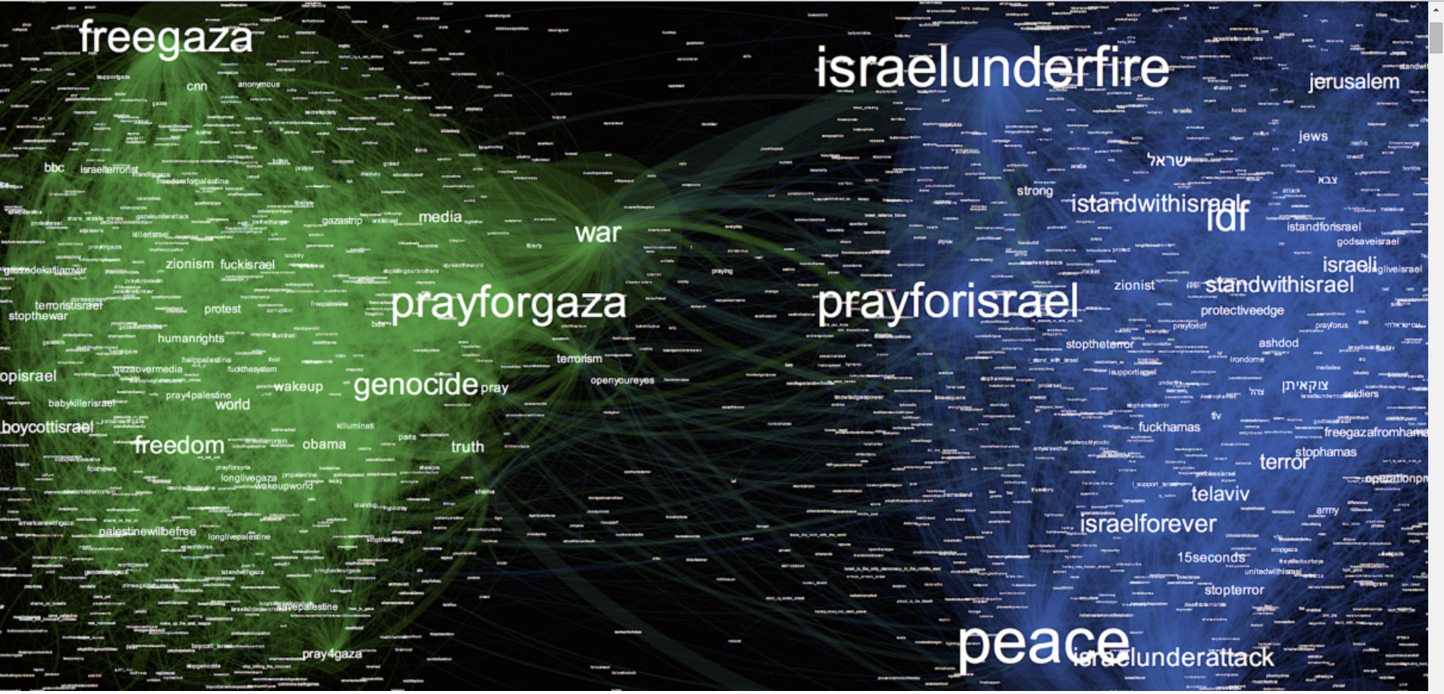
Israel, Gaza, War & Data social networks and the art of personalizing propaganda https://medium.com/i-data/israel-gaza-war-data-a54969aeb23e?_ga=1.225686554.1873778177.1371244953

Slide 35
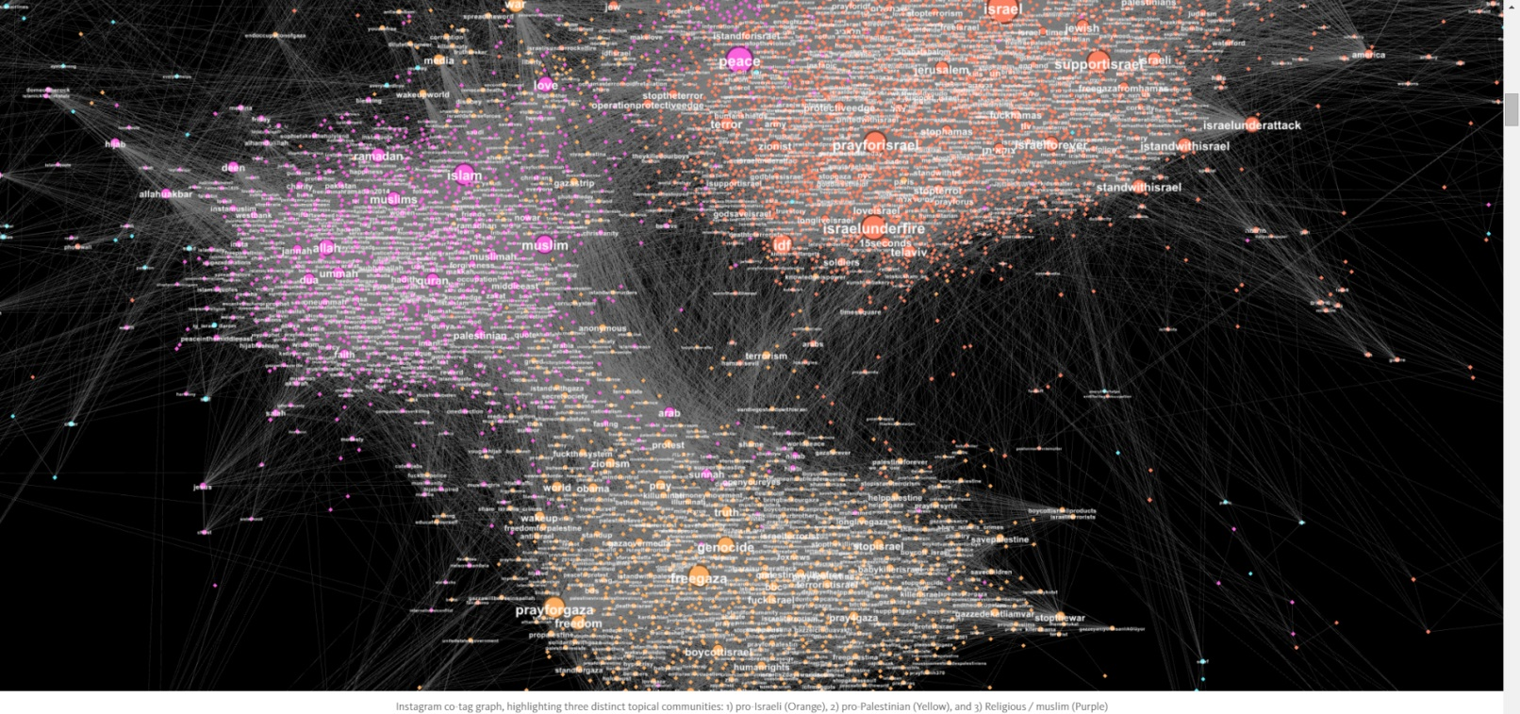
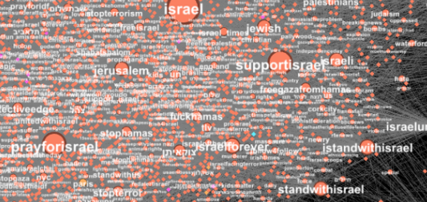
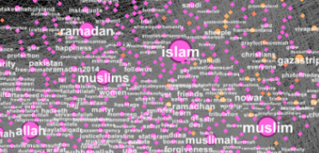
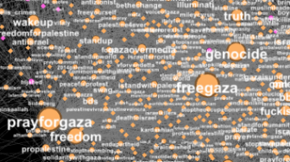
Instagram co-tag graph pro-Israeli (Orange), pro-Palestinian (Yellow), and Religious / muslim (Purple)

Slide 36
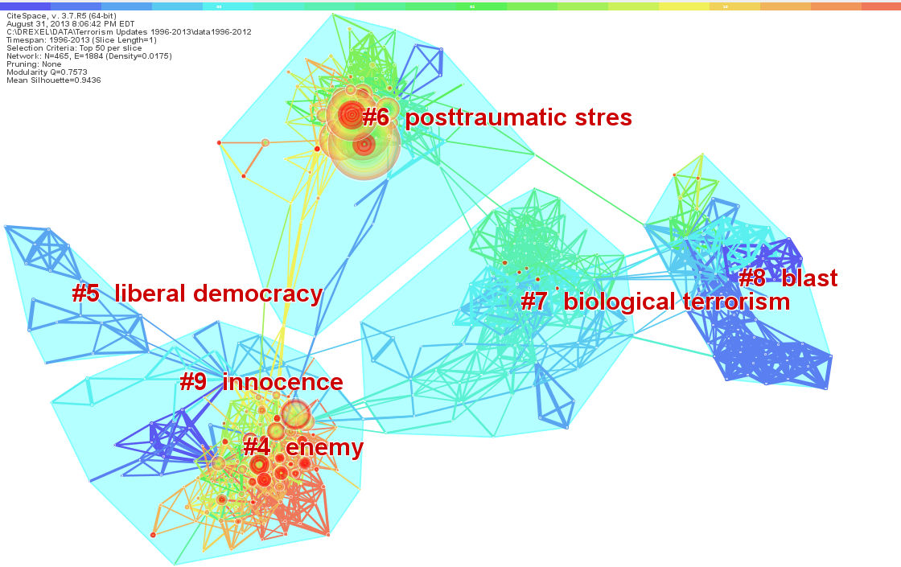

Slide 37
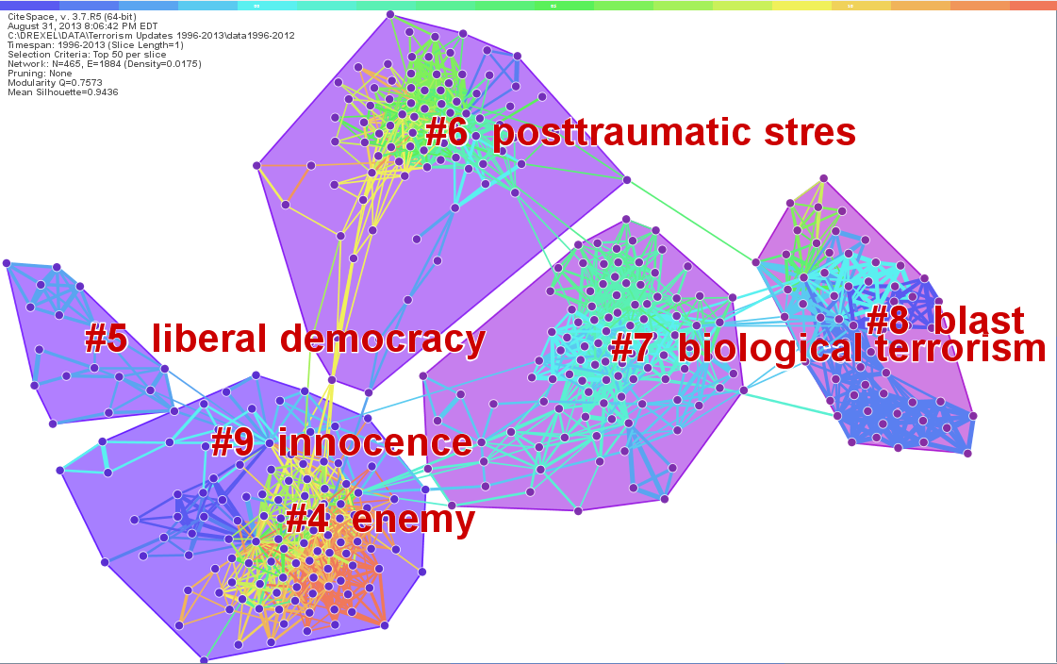

Slide 38
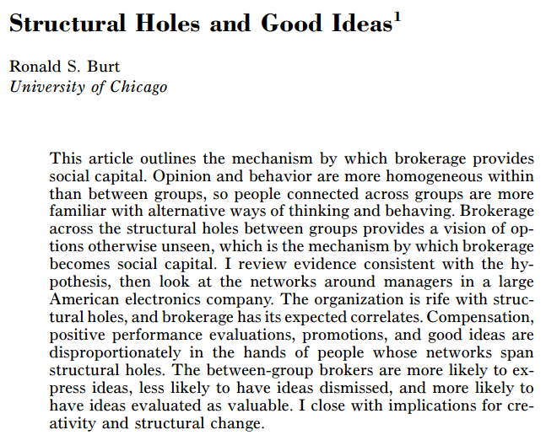

Slide 39
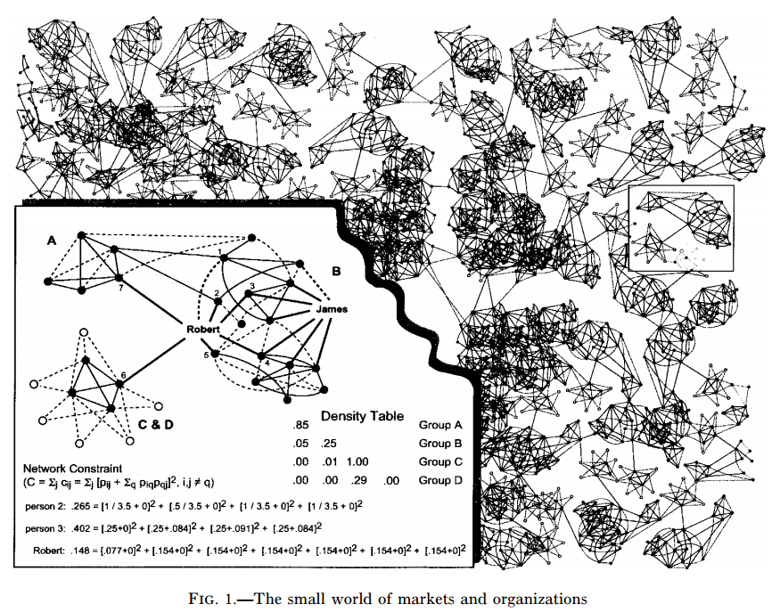

Slide 40
People whose networks span structural holes have early access to diverse, often contradictory, information and interpretations, which gives them a competitive advantage in seeing good ideas.

Slide 41
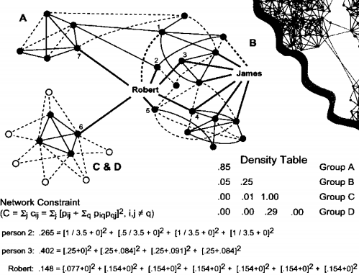

Slide 42
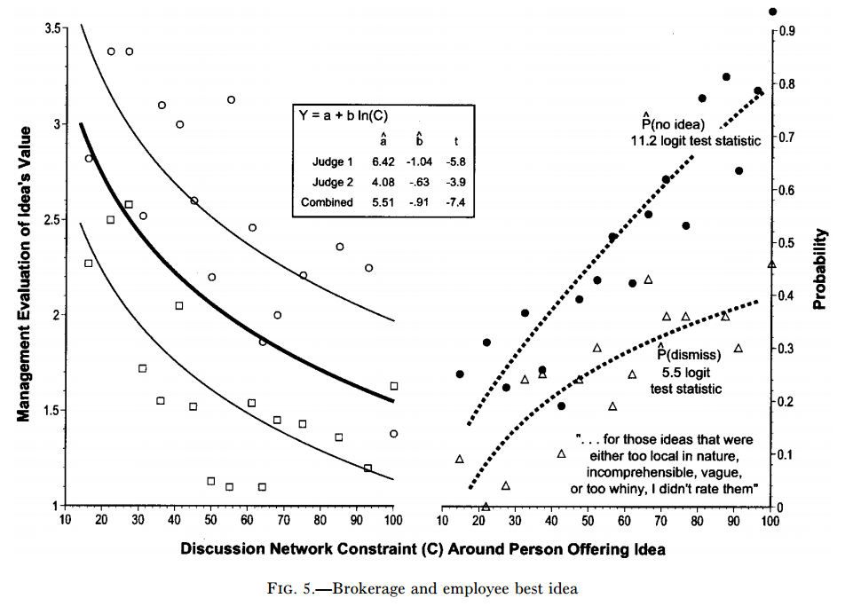
Brokerage ~ Best Idea

Slide 43
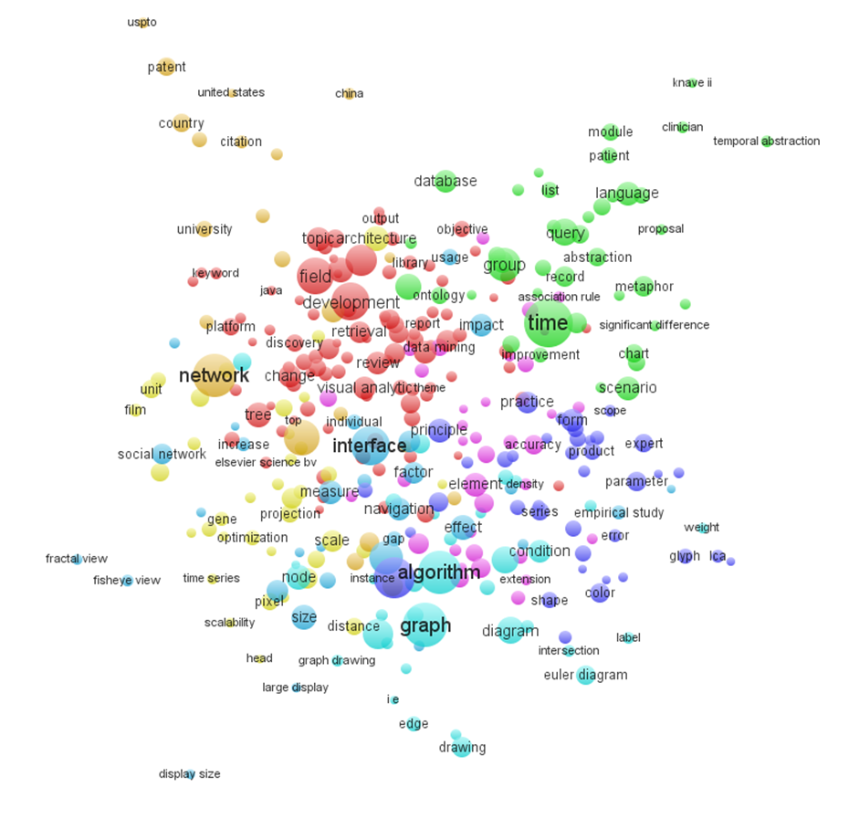
VOSViewer: Label View

Slide 44
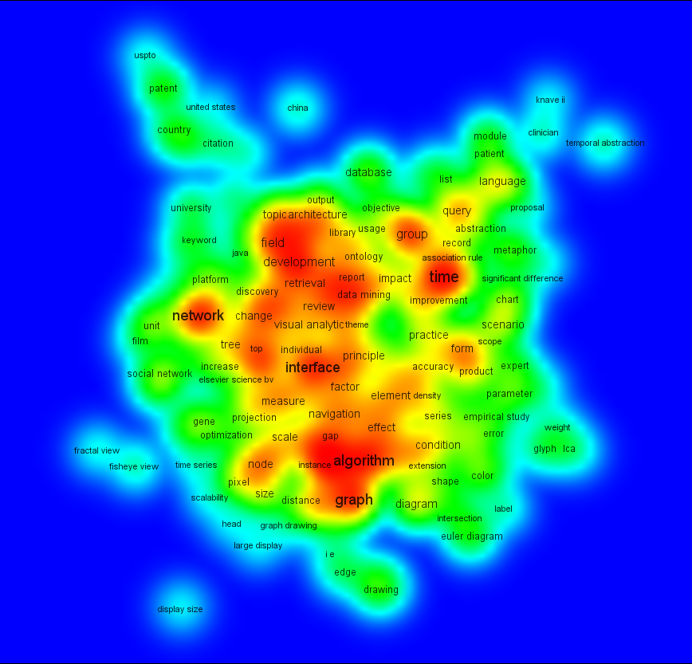
VOSViewer: Density View

Slide 45
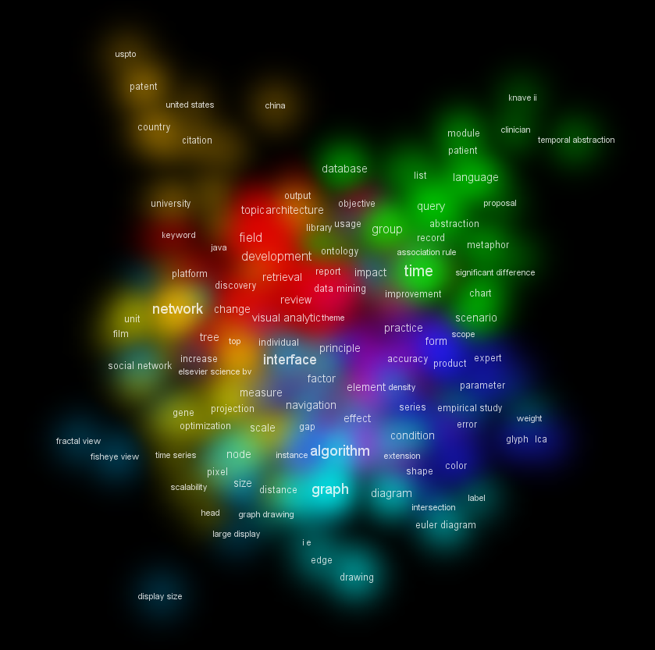
VOSViewer: Cluster Density View

Slide 46
Coordinated views
Section VI

Slide 47
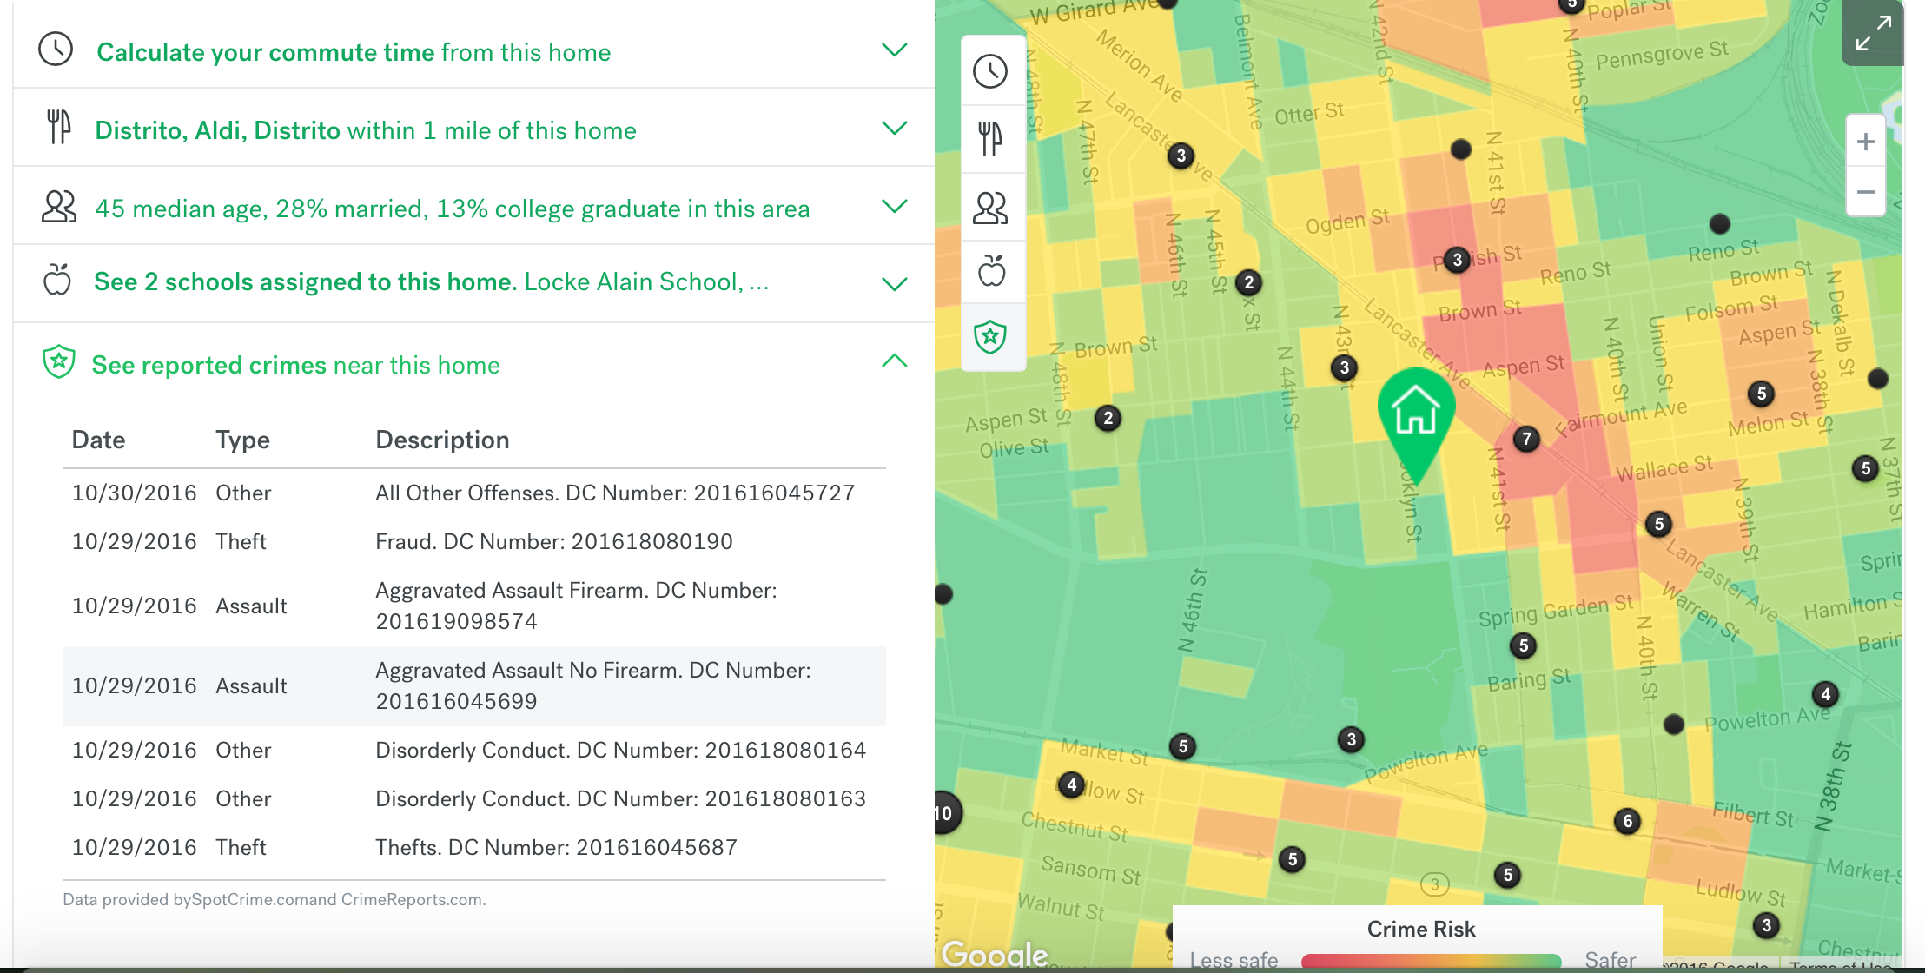
Trulia real estate

Slide 48
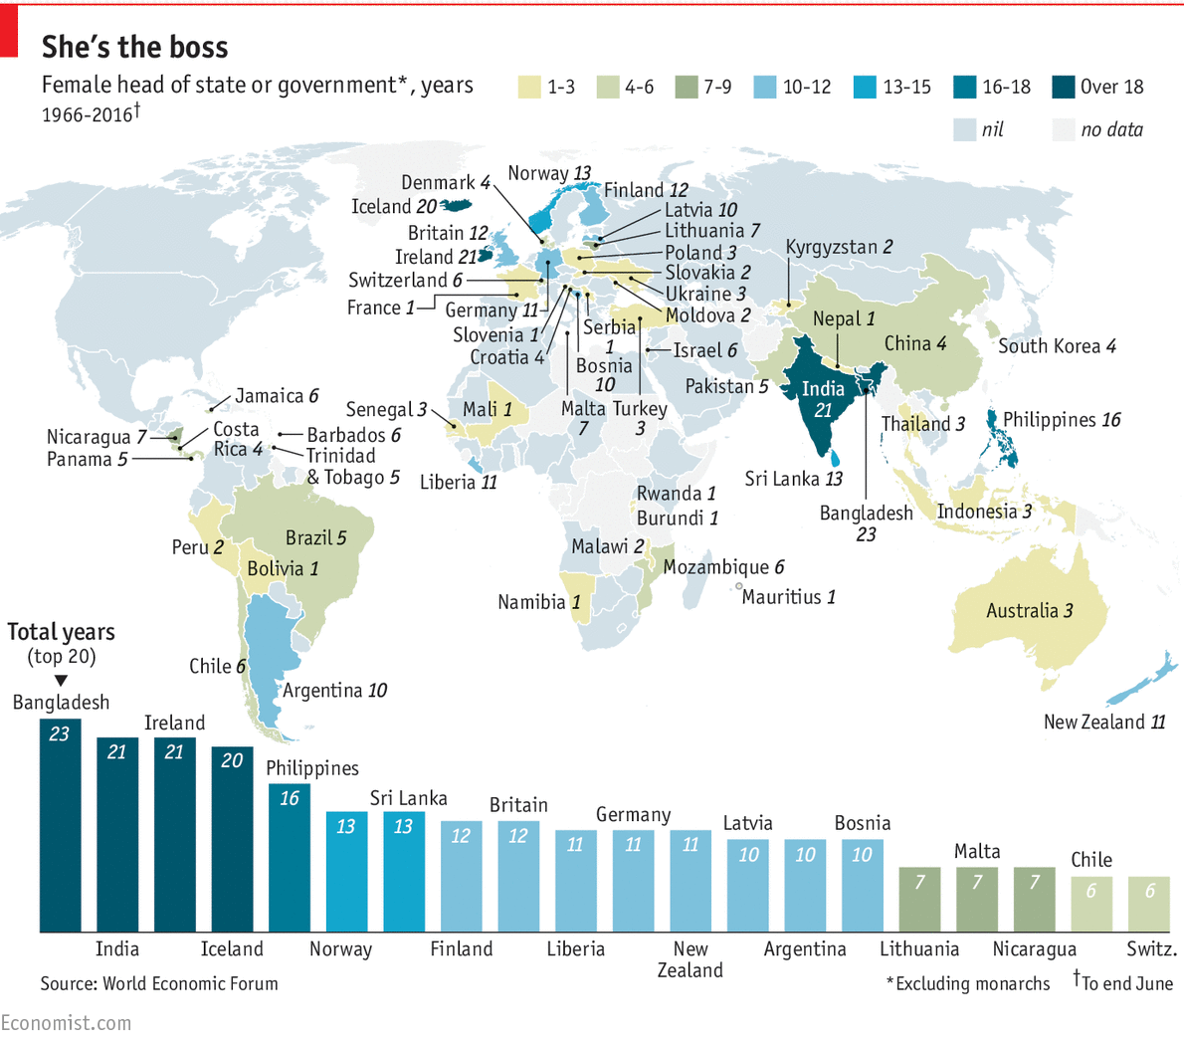

Slide 49
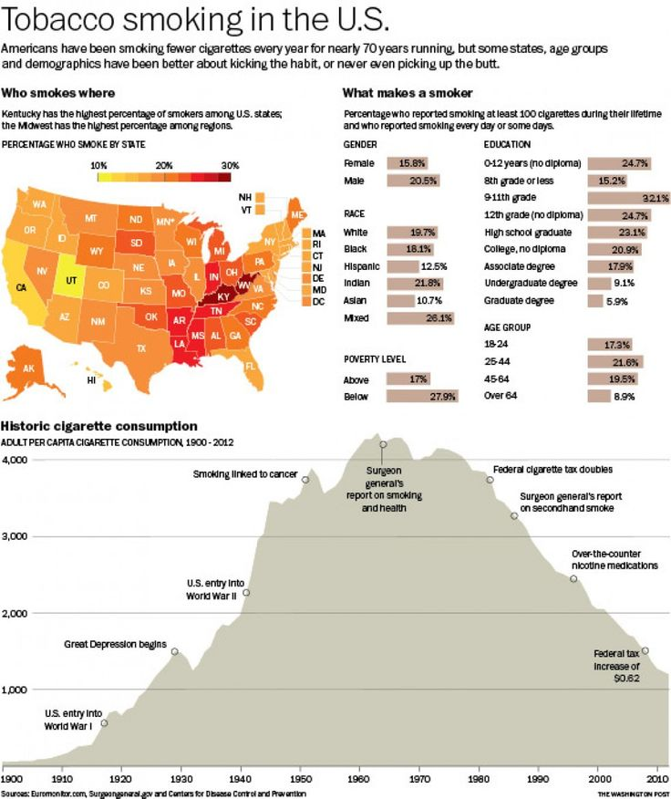

Slide 50
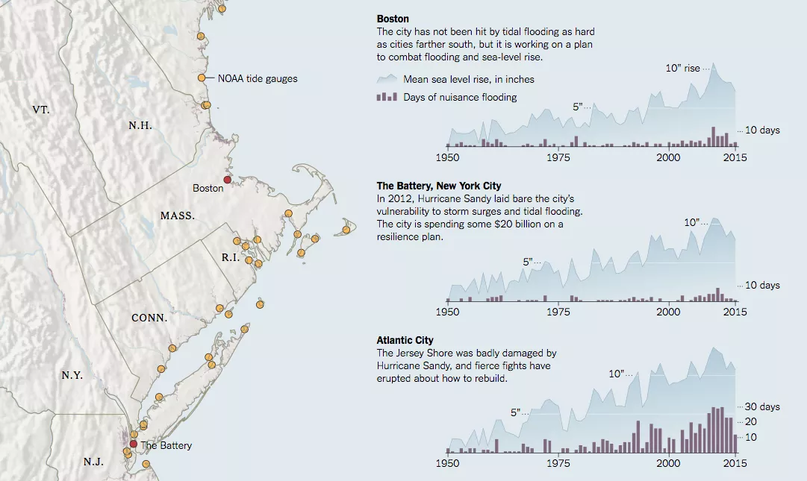

Slide 51
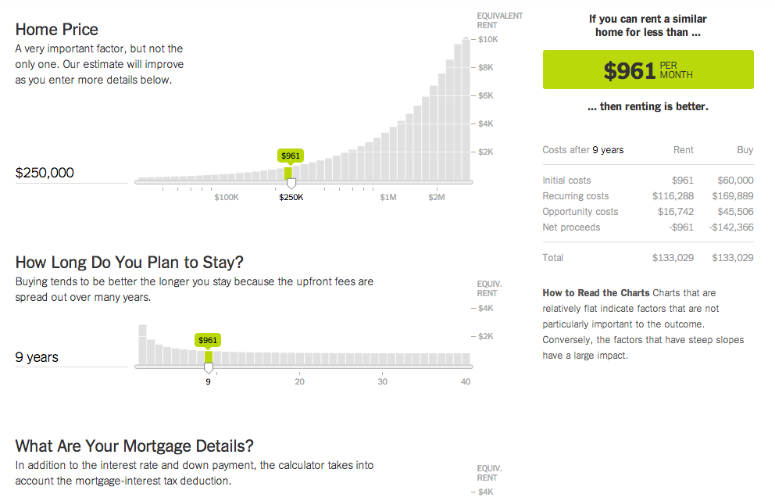

Slide 52
Demos
Section VII

Slide 53
Demos
Tableau
Earthquake data
VOSViewer
Web of Science data

